Slide 1
Customer Support System
SFBU
A Master’s Project report submitted to
School of Engineering
In Fulfillment for the Degree of
Masters of Science in Computer Science
CS589 Generative AI
A genAI powered chatbot
Submitted By-
Professor Adam Weng
Chenxin Cao - 19940
Minh Khoi Duong - 19610
Prachi Sethi - 19963
Prepared under the supervision and guidance of
Professor Henry Chang

Slide 2

INTRODUCTION
Why GenAI?
Innovative tool designed to improve communication and accessibility within the school community.
Cutting-edge AI technology from OpenAI.
Speech Recognition
Provides multilingual support
Presented By-
Prachi Sethi

Slide 3
ARCHITECTURE
+-------------------+
| Processing Layer |
| |
| [Query |
| Understanding] |
| [RAG Mechanism] |
| - Retriever |
| - LLM |
| - LangChain |
| [OpenAI API] |
+-------------------+
+-------------------+
| User Interaction |
| Layer |
| |
| [Voice & Text] |
| - Speech |
| Recognition |
| - Text Input |
| [Content |
| Moderation] |
+-------------------+
+-------------------+
| Processing Layer |
| |
| [Query |
| Understanding] |
| [RAG Mechanism] |
| - Retriever |
| - LLM |
| - LangChain |
| [OpenAI API] |
+-------------------+
+-------------------+
| Response |
| Generation & |
| Delivery Layer |
| |
| [Response |
| Formatting] |
| [Response |
| Delivery]
[Email] |
+-------------------+
Presented By-
Prachi Sethi

Slide 4
TECHNOLOGIES USED
OpenAI API (Chat Completion, Text-to-Speech, etc.)
LangChain (langchain-community, langchain-experimental)
Chromadb (Text Splitting, Vectorstores, Embeddings, etc.)
Streamlit (for server-streaming)
Fine-Tuning, Evaluation, Moderation, Hallucinations Prevention
Khoi Duong

Slide 5
MODERATION
Evaluate Inputs, Moderation to create Responsible AI (no hate, self-harm, sexual content, and violence)
Preventing Prompt Injection - users manipulating the AI system to bypasses intended instructions:
Using Delimiters and Clear Instructions in System
Using an Additional Prompt
Few-shot Learning ⇒ The LLM model learns desired behavior by example
Khoi Duong

Slide 6
FEATURES
AI-Driven Multilingual Support
Speech Recognition
Dynamic Information Retrieval
Universal Accessibility
Email Generation
Presented By-
Chenxin Cao

Slide 7
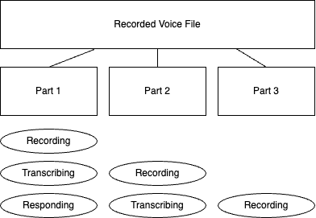
REAL-TIME SPEECH - RECOGNITION
Queue Streaming - Improve the responding speed
Presented By-
Chenxin Cao

Slide 8
SPEECH - RECOGNITION
OpenAI Whisper
Introduction to Whisper: A speech recognition model developed by OpenAI.
Accuracy Across Languages: Exceptional performance in diverse languages, making it ideal for multilingual support.
Robust in Noisy Environments: Maintains accuracy even in challenging audio conditions.
Adaptability: Easily integrates with existing systems, enhancing our chatbot responsiveness and efficiency.
Presented By-
Chenxin Cao

Slide 9
SPEECH - OUTPUT
OpenAI & Google TTS Integration
Natural and Expressive Speech: Both technologies provide high-quality, natural-sounding voice responses, enhancing user interaction.
Wide Language Support: Expansive language and dialect coverage ensures inclusivity for our diverse user base.
Presented By-
Chenxin Cao

Slide 10
FINE TUNING
Fine-tuning is the process of customizing pre-trained AI models to adapt to specific tasks or domains.
In the context of our school chatbot, fine-tuning allows us to tailor the AI model's responses to better suit the unique needs and requirements of our school community.
Presented By-
Prachi Sethi

Slide 11
FINE TUNING
Process Overview
Data Collection
Preprocessing
Fine-Tuning (Training the model)
Evaluation
Iteration
Presented By-
Prachi Sethi

Slide 12
FINE TUNING
Benefits and Impacts
Personalization
Accuracy
User Satisfaction
Efficiency
Continuous Improvement
Presented By-
Prachi Sethi

Slide 13
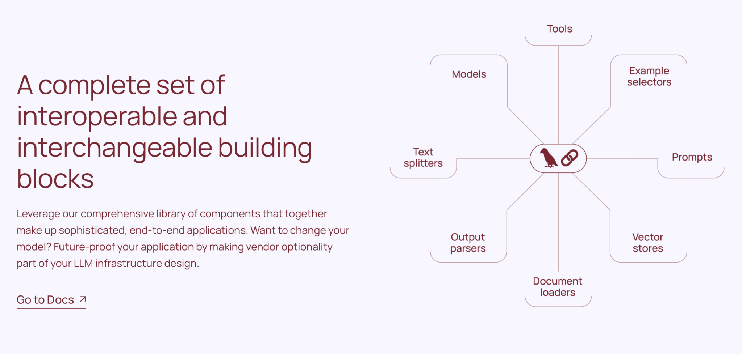
LANGCHAIN AND DOCUMENT LOADING
What is Langchain?
Presented By-
Chenxin Cao

Slide 14
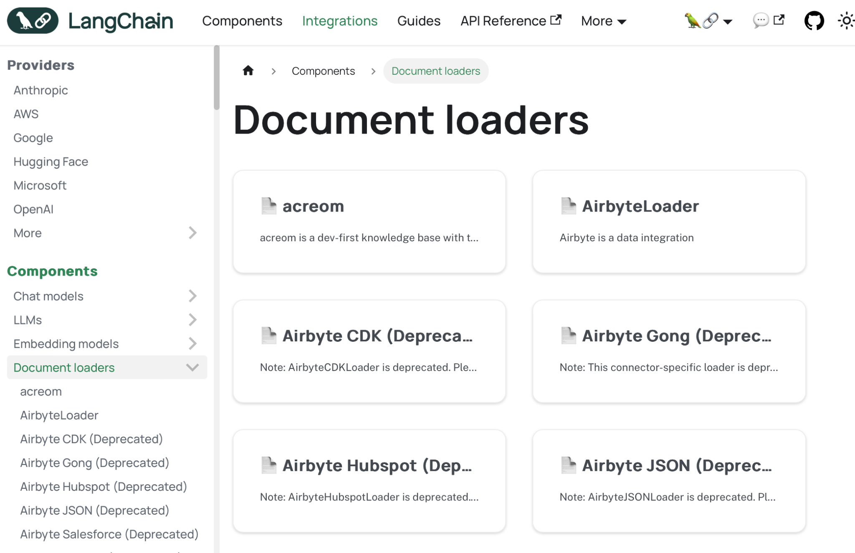
LANGCHAIN AND DOCUMENT LOADING
Langchain offers a significant amount of document loaders
Presented By-
Chenxin Cao

Slide 15

LANGCHAIN AND DOCUMENT LOADING
PyPDF
Portable Document Format (PDF), standardized as ISO 32000, is a file format developed by Adobe in 1992 to present documents, including text formatting and images, in a manner independent of application software, hardware, and operating systems.
Presented By-
Chenxin Cao
Our Primary Document: 2023 Catalog.pdf

Slide 16
RAG
Definition: Retrieval-Augmented Generation (RAG) is a method that combines a language model with a retriever that searches external knowledge sources to provide additional context for generating more accurate and relevant responses.
How It Works:
A retriever fetches relevant documents or data from external sources based on a query or prompt.
The language model uses this retrieved information to generate a response.
Purpose: Enhance the quality, relevance, and factual accuracy of responses by leveraging up-to-date information from external sources.
Presented By-
Prachi Sethi

Slide 17
RAG
Improved Accuracy: Incorporates up-to-date information, leading to more accurate and fact-based responses.
Contextual Responses: Uses additional context to provide more nuanced and context-aware answers.
Reduced Hallucination: By grounding the language model's output in retrieved data, the risk of generating false or misleading information is minimized.
Customizability: Can be fine-tuned to specific domains or use cases by focusing on relevant sources.
Presented By-
Prachi Sethi

Slide 18
SAFETY AND PRIVACY
Prompt:
Injections
Proactive Injection Detection
Prompt & Response:
Hallucination
Personally Identifiable Information (PII)
Toxicity
Sentiment analysis (Prevention from Negativity, Hate, Assault Speech)
Regexes (Regex pattern matching for sensitive information)
Khoi Duong

Slide 19
FUTURE SCOPE
Enhanced Natural Language Understanding (NLU)
Multimodal Support (voice input/output, image recognition, and video responses)
Personalization and Context Awareness
Integration with Existing Systems
Feedback Mechanisms
Language and Cultural Adaptability
Integration with Social Media and Messaging Platforms
Khoi Duong

Slide 20
CONCLUSION & CHALLENGES
CHALLENGE 1: Which Model?
CHALLENGE 2: API Upgrades
Presented By-
Chenxin Cao

Slide 21
CONCLUSION
Why choose us?
Presented By-
Chenxin Cao

Slide 22

DEMO

Slide 23
Q & A

Slide 24
THANK YOU

